Slide 1


FeedRoad
Presented By-
Karan Dogra(229038)
Manish Dubey(229043)

Slide 2
Points to be discussed
Screenshots
Specification
Conclusion
Introduction
Motivation
Future Enhancement
References
S/W and H/W
Requirement
Objectives
Diagrams

Slide 3
Introduction
The FeedRoad is for the Business Owners/Product Managers providing the complete solution for registered users (Members) through single gateway using internet that will help them to create, send and collect customer opinions about their Product/Company/Services over Emails.

Slide 4
Motivation
Today, companies in every industry face a battle for customer loyalty. This is no longer just about price, promotions and quality; experience also plays an important role. This is why organizations have implemented an approach called customer centricity.
Customer centricity is a business strategy based on putting the customer first and at the center of the business to deliver a positive customer experience and build long-term relationships.
This sales and marketing concept places customers rather than the product at the center of interest. Thus, customer expectations, needs and desires form the starting point of marketing campaigns which is where there feedbacks plays a crucial role in enhancing company growth.

Slide 5
Objectives
The main purpose of this system, is to enhance the market value of the Product/Services through which Customer Engagement can be enhanced and Customer Satisfaction can be achieved which will help the Product Managers/Start Up Owners to repositioned their products as per the market needs.
Our Feedback Collection Application has, following objectives:
•Simple database is maintained
•Easy operations for the creation of multiple campaigns
•User interfaces are user accommodating and attractive; it takes very less time for the member to use the system
•The overall aim is to design an application which allow members to create multiple campaigns, send and collect feedbacks from the prospective clients which then that will be used to improve the quality of the product.

Slide 6
Technology Used:
MERN(Mongo dB, Express JS, React, Node JS

Slide 7
Diagrams

Slide 8
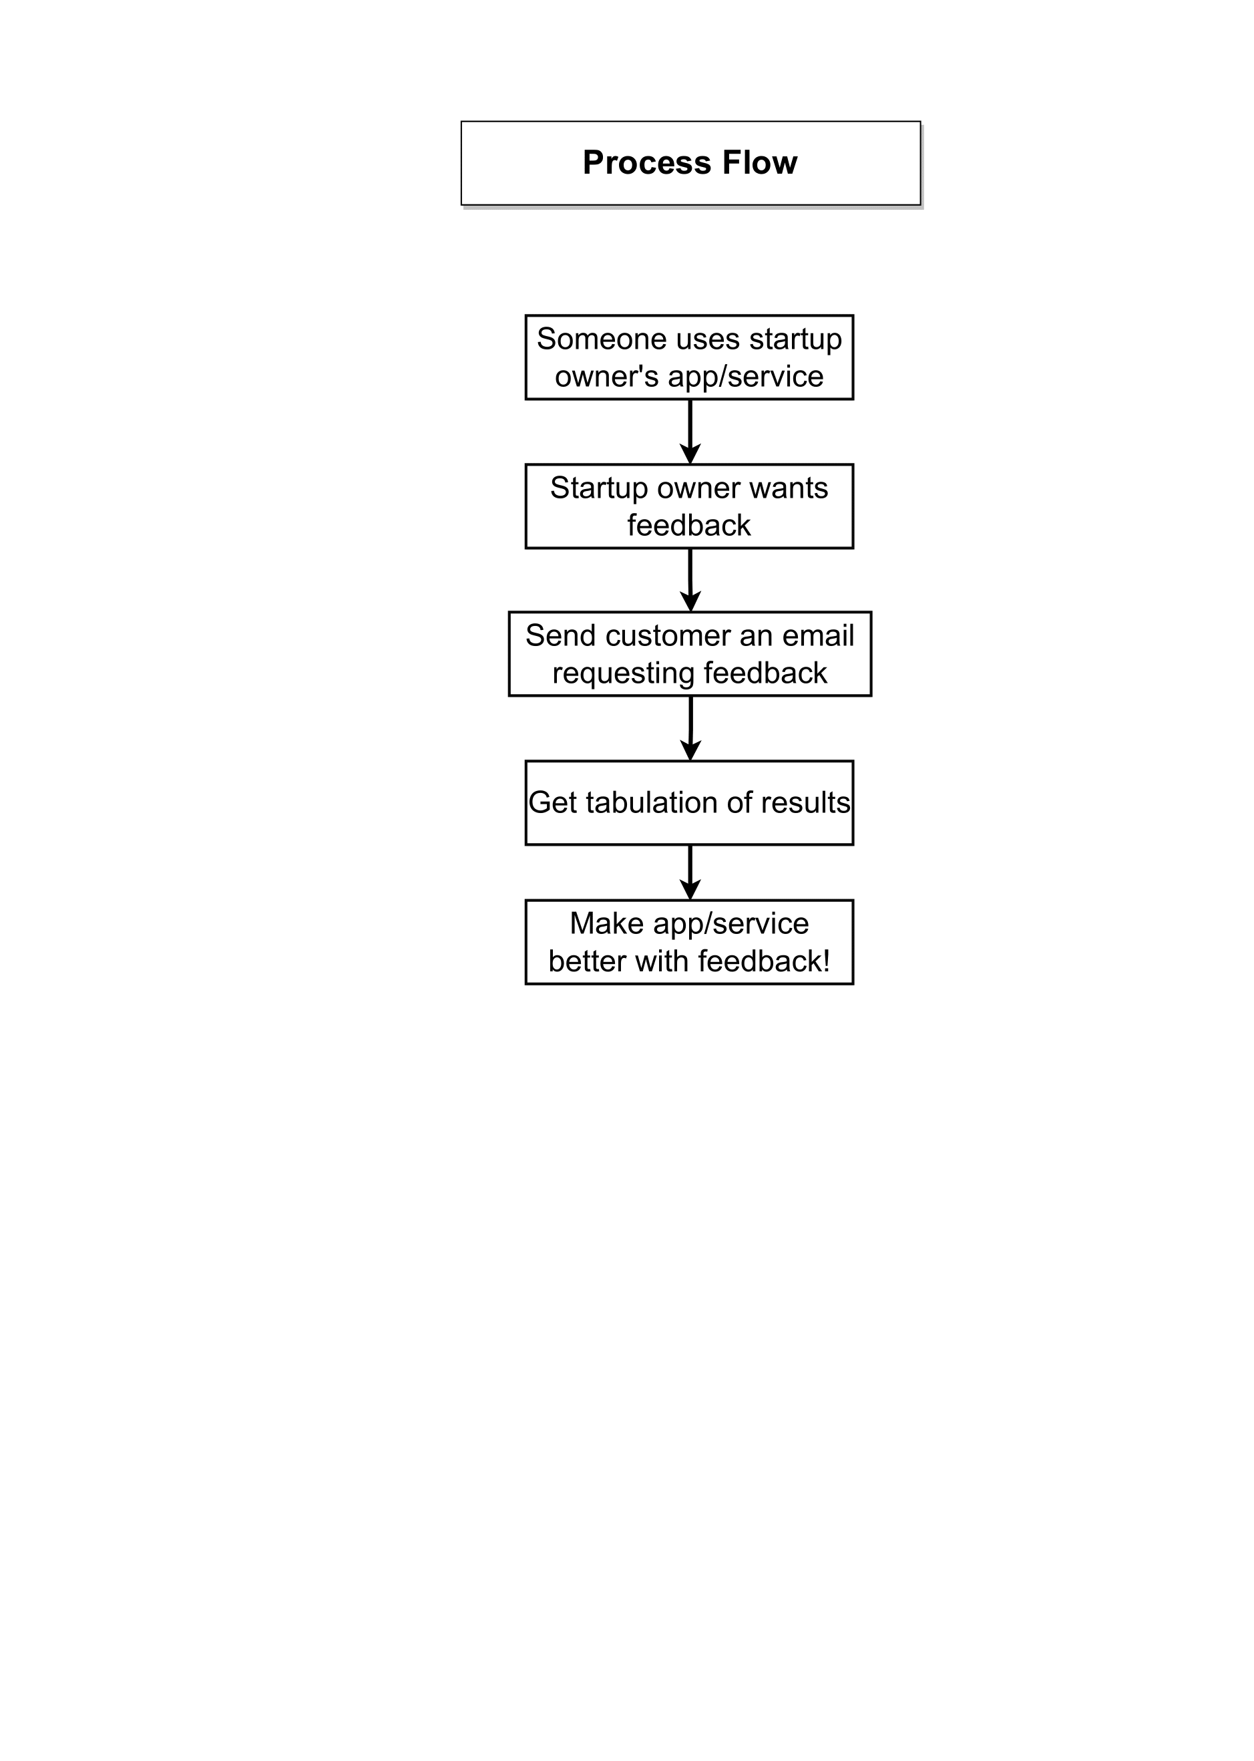
Basic Process Flow Diagram

Slide 9
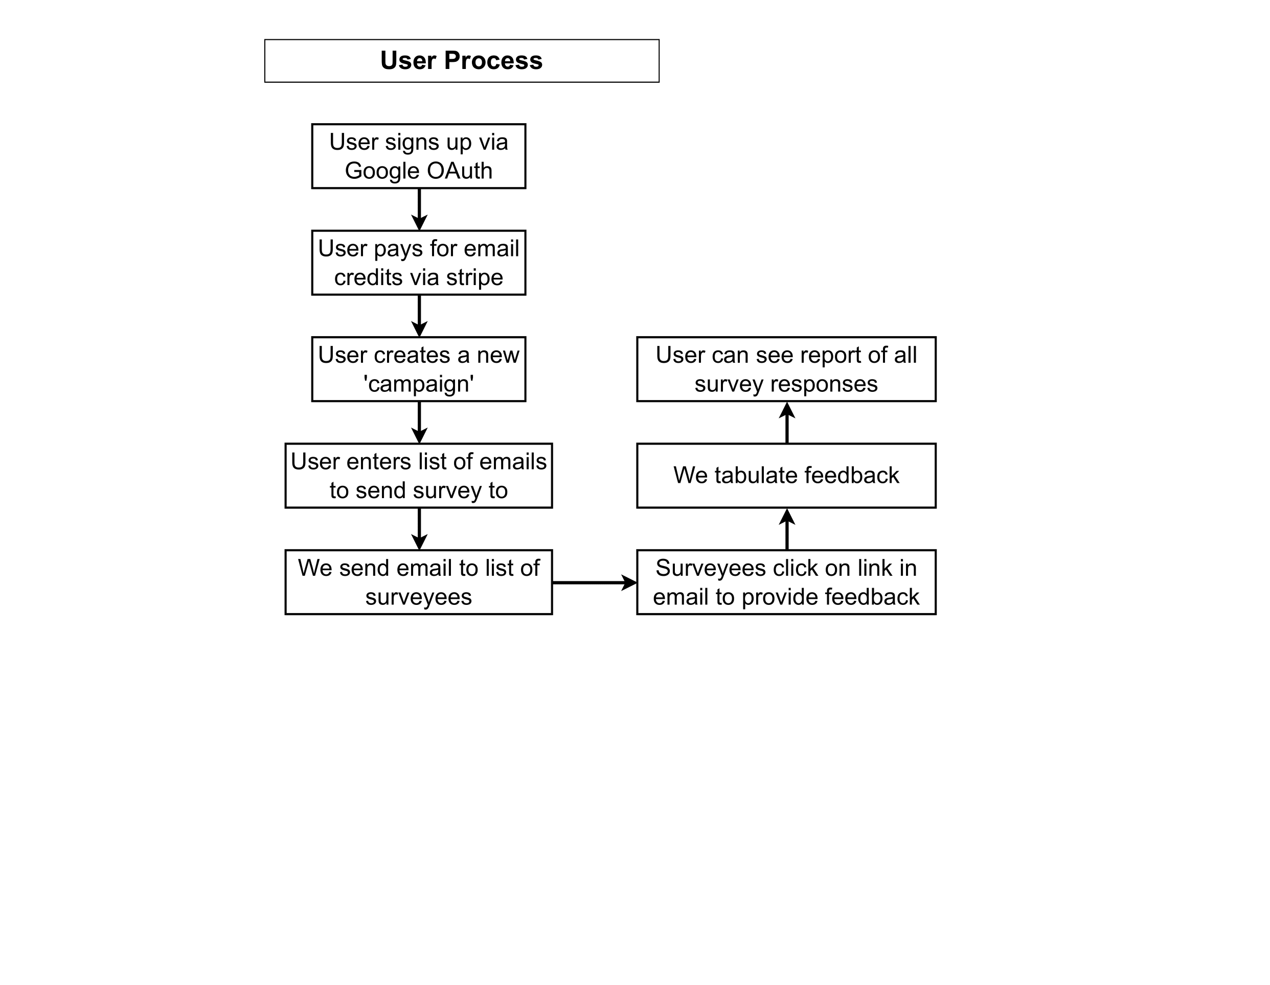
User Process Flow Diagram

Slide 10
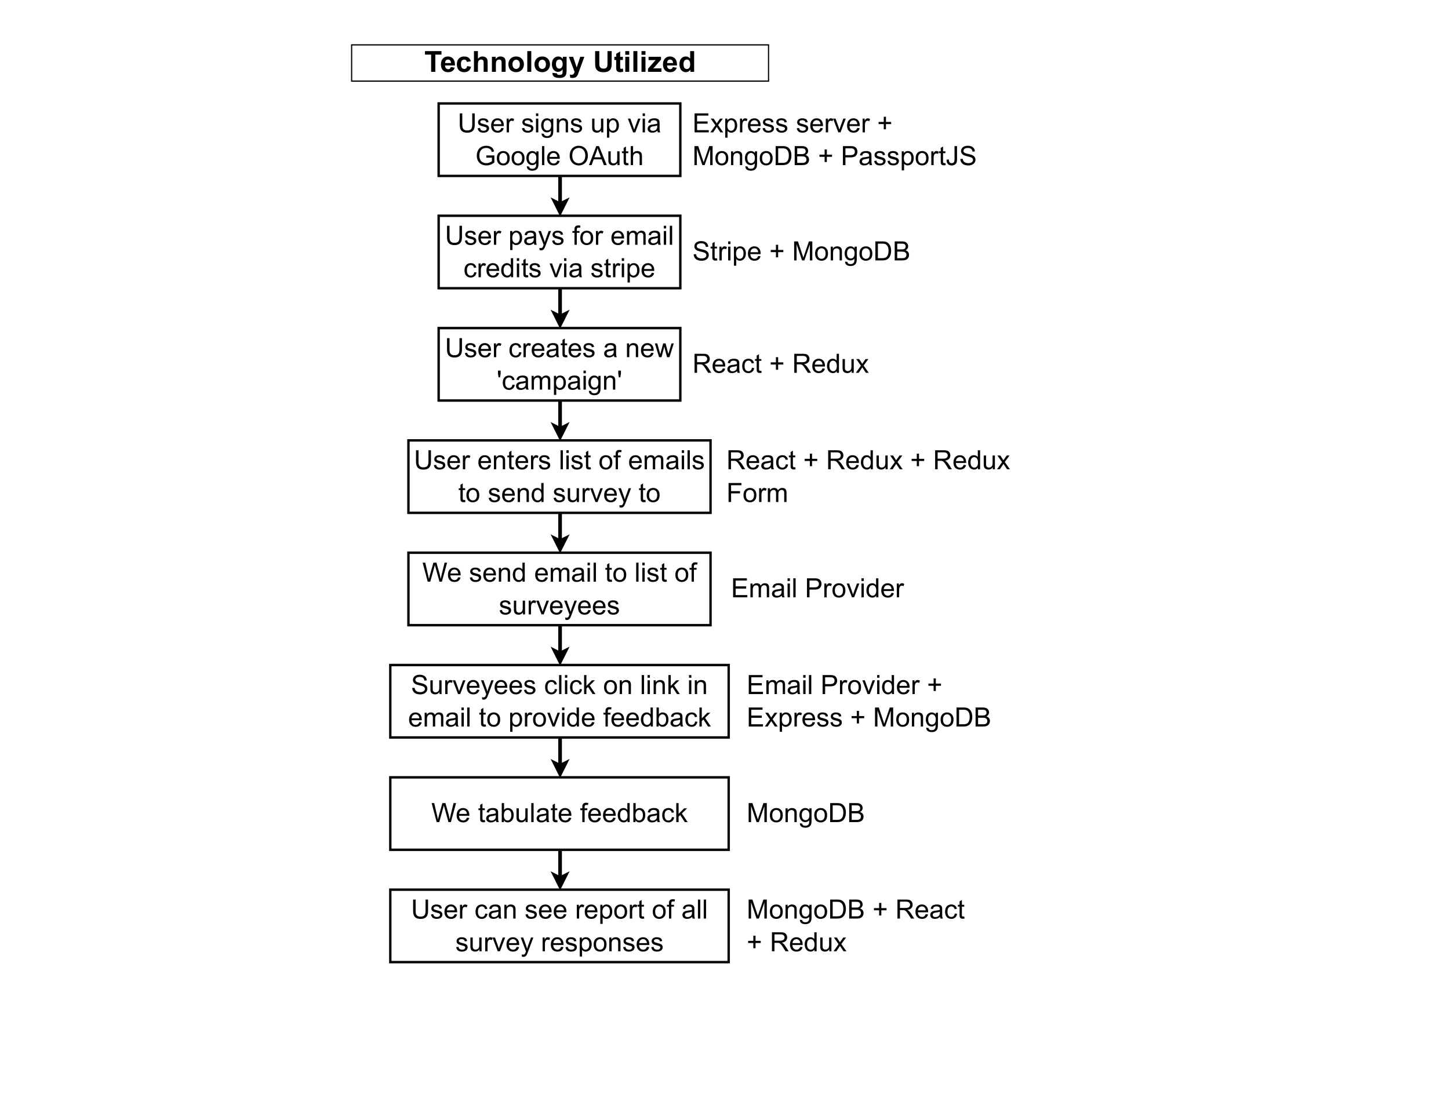
Technology Utilized

Slide 11
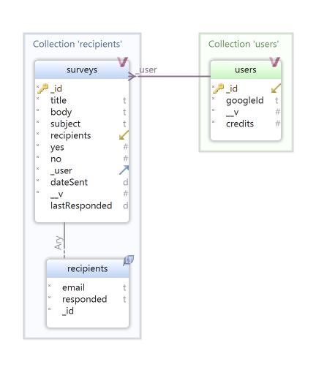
Mongo DB Model Database Schema

Slide 12
Screen Shots

Slide 13
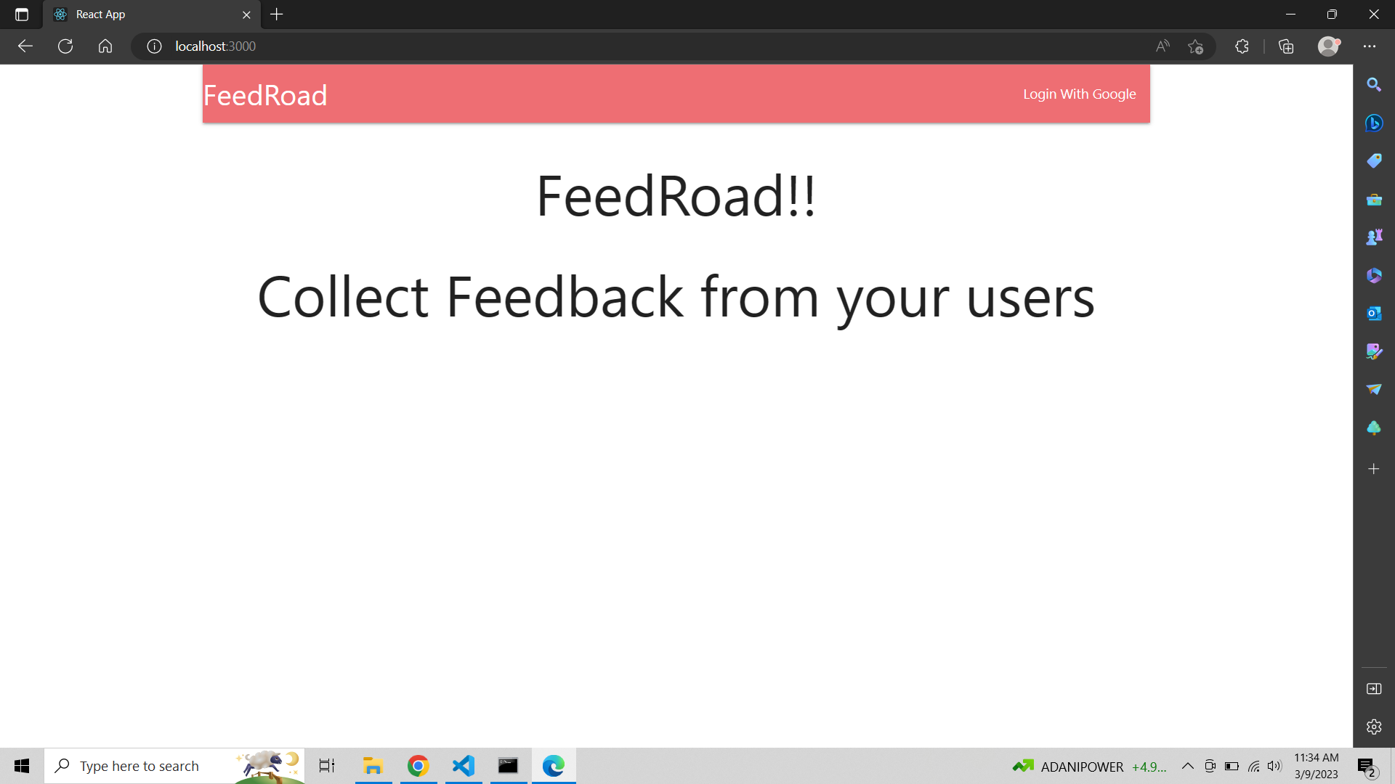

Slide 14
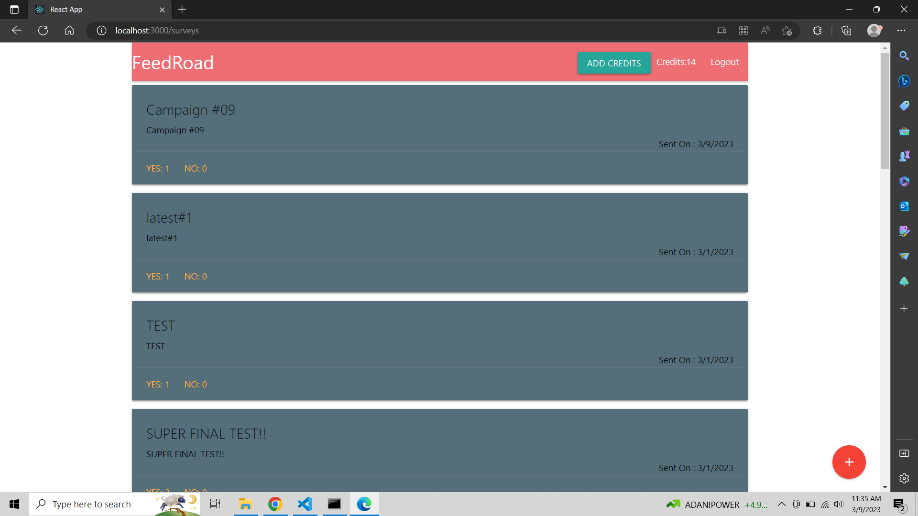

Slide 15
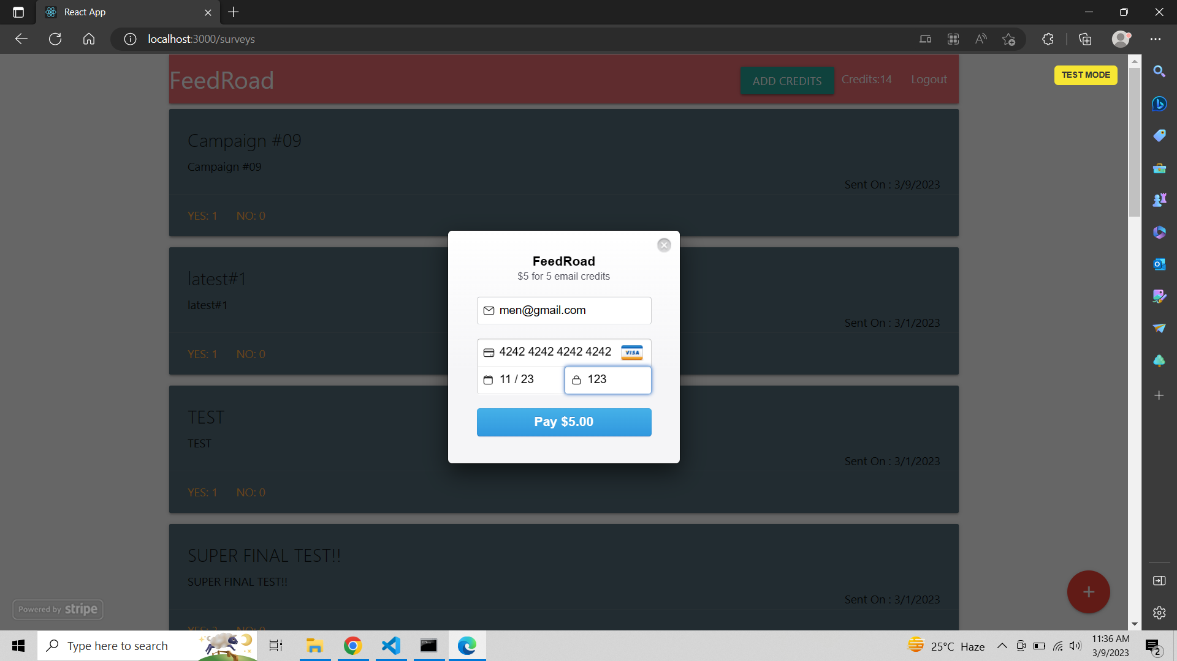

Slide 16
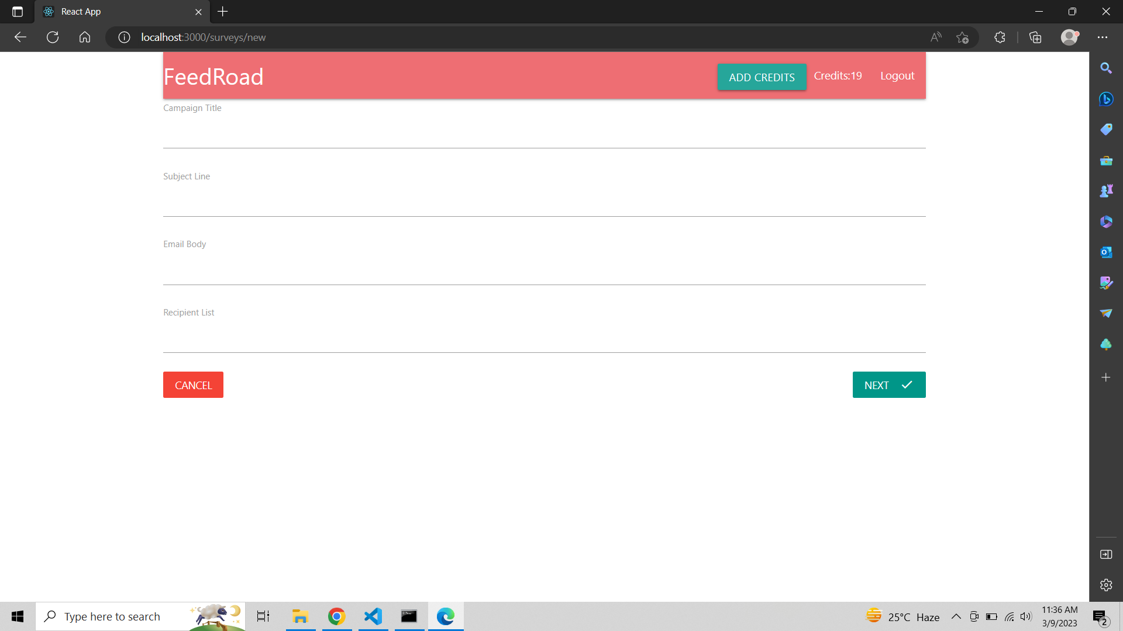

Slide 17
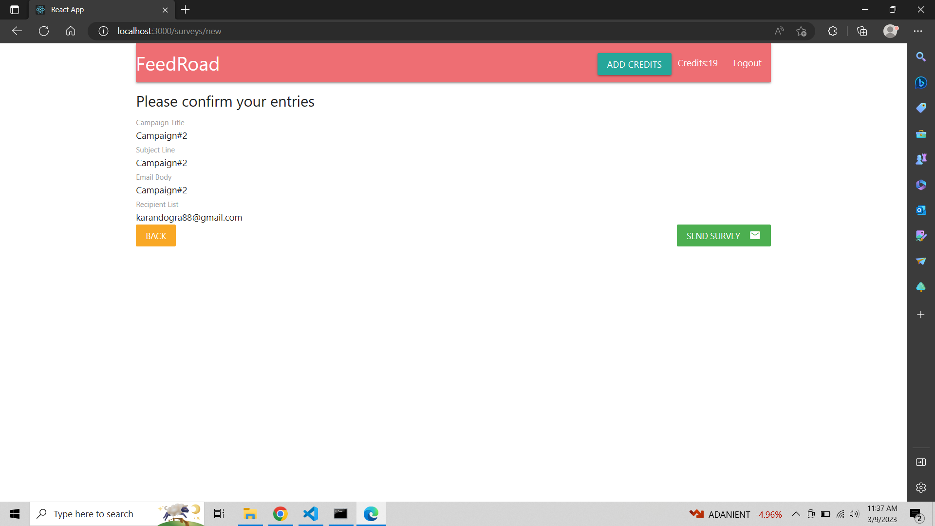

Slide 18


Slide 19
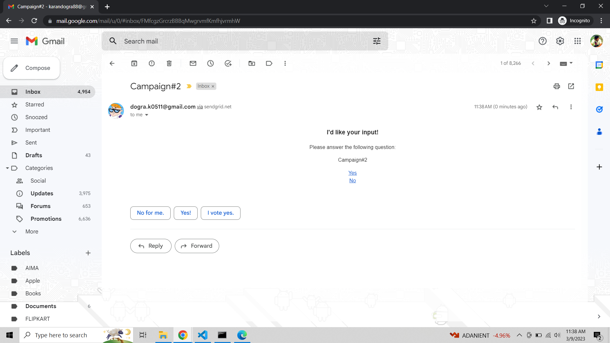

Slide 20
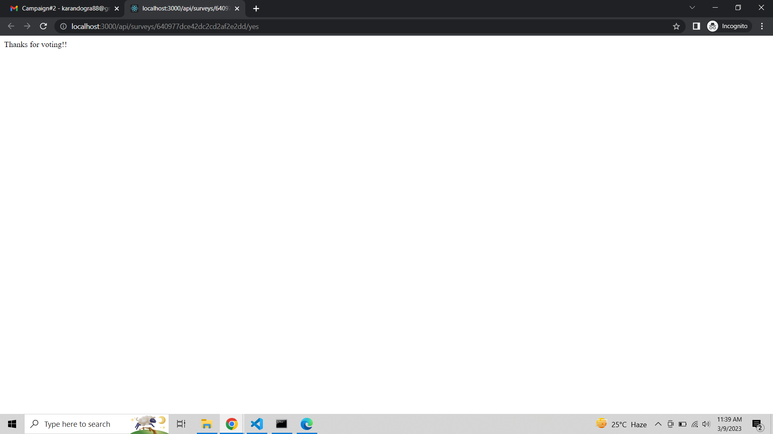

Slide 21


Slide 22
Specification
•The application will use JavaScript, jQuery and CSS as main web technologies.
•HTTP and FTP protocols are used as communication protocols. FTP is used to upload the web application in live domain and the client can access it via HTTPS protocol.
•SMTP protocol is used for email communication.
•Several types of validations make this web application a secured one and SQL Injections can also be prevented
•Since FeedRoad is a web-based application, internet connection must be established.
•The FeedRoad will be used on PCs and will function via internet or intranet in any web browser

Slide 23
S/W and H/W Requirements
Server Side:
Processor: Intel® i5 processor series and above
HDD: Minimum 500GB Disk Space
RAM: Minimum 8GB
OS: Windows 10, Linux 6
Database: MongoDB
Client Side (minimum requirement):
Processor: Intel Dual Core
HDD: Minimum 80GB Disk Space
RAM: Minimum 8GB
OS: Windows 10, Linux 6

Slide 24
Conclusion
This project aid in automating the existing manual feedback collection system.
This is a paperless work.
It can be monitored and guarded remotely. It cut down the man power required and provides accurate information.
All years together huddled information can be saved and can be accessed at any time.
For this reason, the data stored in the repository helps in taking decision by management.
All the stakeholders, faculty and authority can get the required information without delay.

Slide 25
Future Enhancement
This project can be enhanced further by allowing surveys to be created in 'draft mode'. The software is flexible enough to be modified and implemented as per future requirements.

Slide 26
References
https://www.w3schools.com/
https://www.mongodb.com/languages/mern-stack-tutorial
https://bootstrapmade.com/mentor-free-education-bootstrap-theme/
https://www.knowledgehut.com/blog/web-development/mern-stack-project-ideas
https://www.geeksforgeeks.org/mern-stack/

Slide 27
THANK YOU

